Slide 1
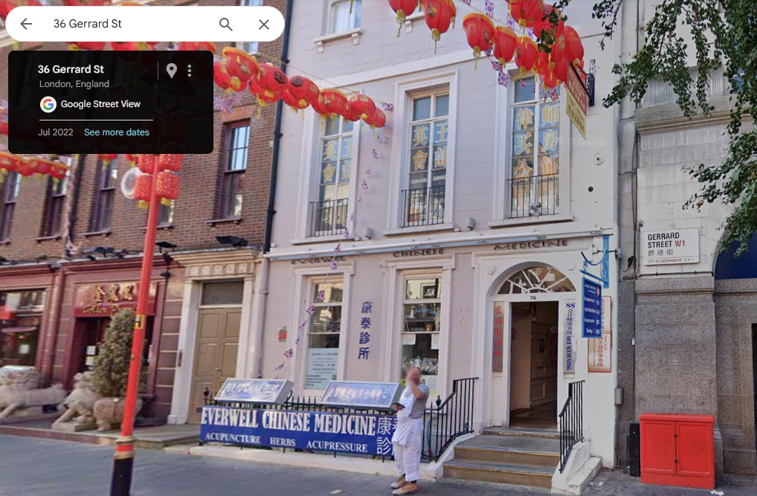
Case Study – Companies who are “Care Of”
Scenario:
  Search first line of Companies address looking for “C/O” (Care of) and then select where the PSC nationality contains “chin”
Standout finding:
  109 Companies under “C/O IP Global”
  Address is register to 36 GERRARD STREET in London which is above a Chinese medicine shop
  Most companies are named “JWZ-IP-### LIMITED”
  PSC for “JWZ-IP” is “Zhang:Jingwei::1990:08” of Chinese nationality where the country of residence is mostly Greece
  Business SIC Code is: 68209 - Other letting and operating of own or leased real estate

