Slide 1
Case Study: ‘The Naildy’
July 2024
This Scenario uses data which has been downloaded from Companies House which is in the public domain

Slide 2
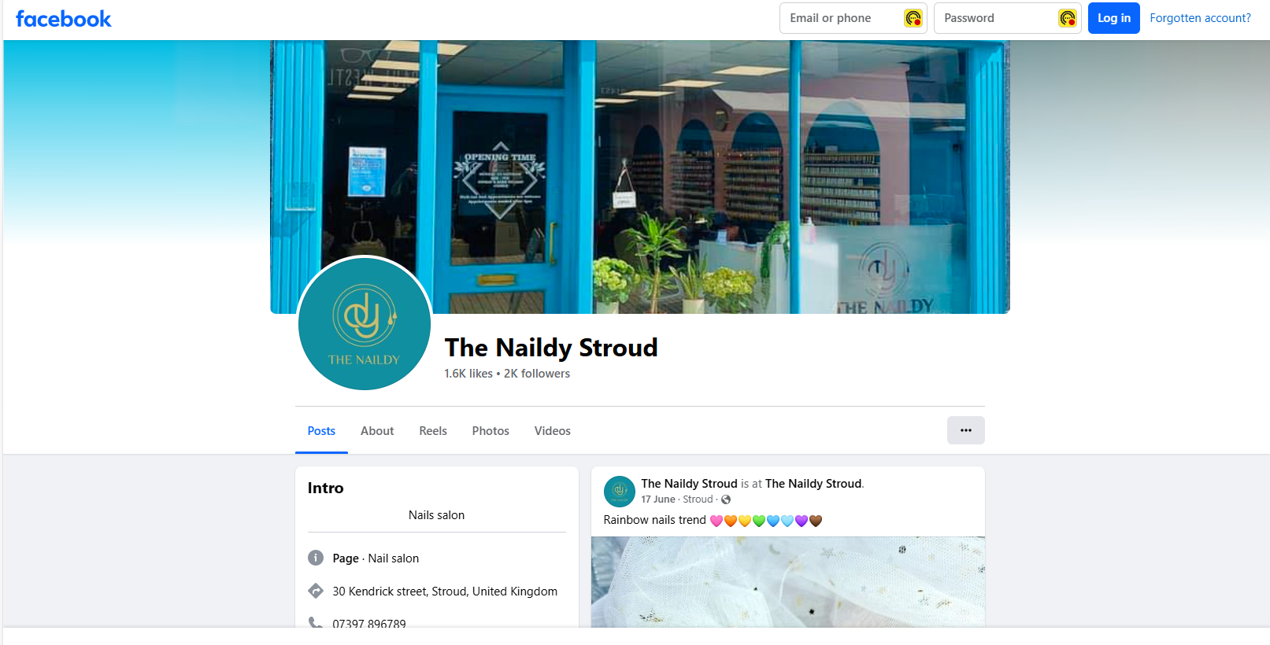
Background
"The Naildy" is a nail bar in Stroud https://www.facebook.com/thenaildystroud.
Note: The registered address is not in Stroud.

Slide 3
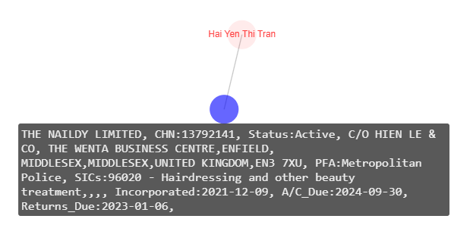
The Registered Company
On a first look, there is nothing very interesting in terms of links. One PSC (Person of Significant Control) and no links to other companies.
However, looking at the registered address it refers to "C/O Hien Le & Co”…….

Slide 4
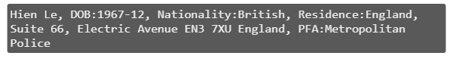
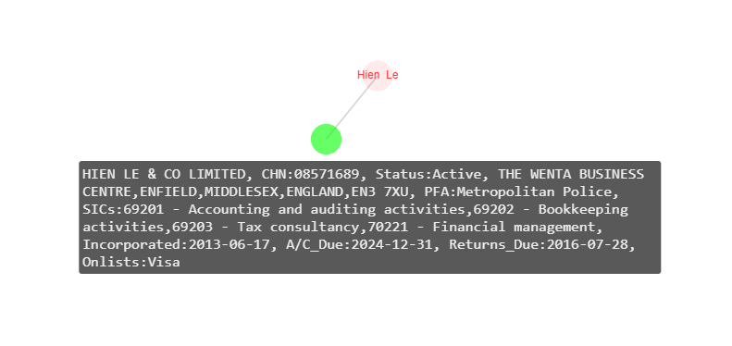
Hien Le & Co Limited
Hien Le & Co are Chartered Accountants with one PSC. They are potentially on the Temporary Visa List. https://www.hienle.co.uk/
How many other companies have the registered address referring to "C/O Hien Le & Co”?

Slide 5
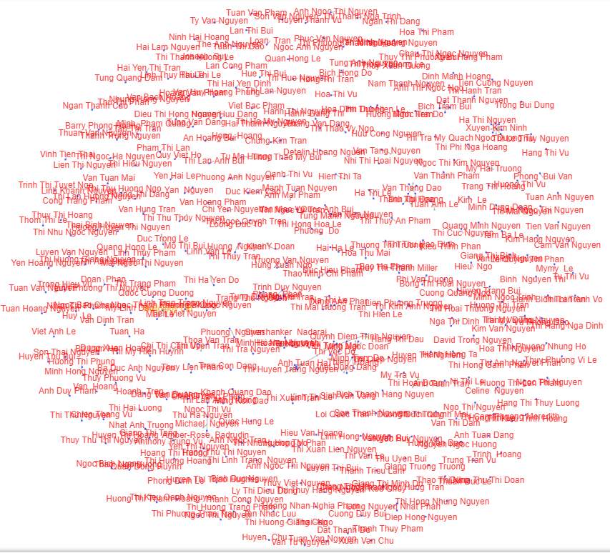
Registered with Hien Le & Co
Searching for all companies which have "C/O Hien Le & Co" in their Registered Address yielded 341 companies, many of which are nail bars (SIC Hairdressing & Beauty), which follow the same pattern i.e. one or two PSC but no links between them. By looking at PSCs where the nationality is Vietnamese would reduce this to 250 companies.

Slide 6
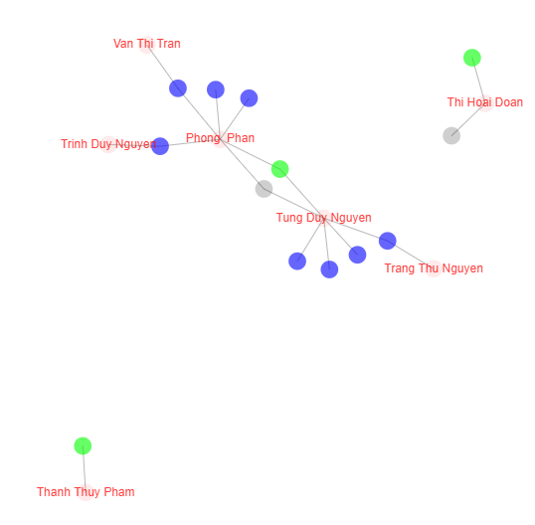
Temporary Visa Lists
How many are potentially on the visa list ?
Only 3 companies (green nodes) were identified, 2 of which are Hair and Beauty related.
Note: Matching to the Temporary Visa List is not perfect as phonetic matching is used.

Slide 7
Observation
Even though the phonetic matching is not perfect, should we expect to see more companies on the Temporary Visa List, given the make of the employee set?
Does this mean that visas are supplied by companies outside of this network?

